Slide 1
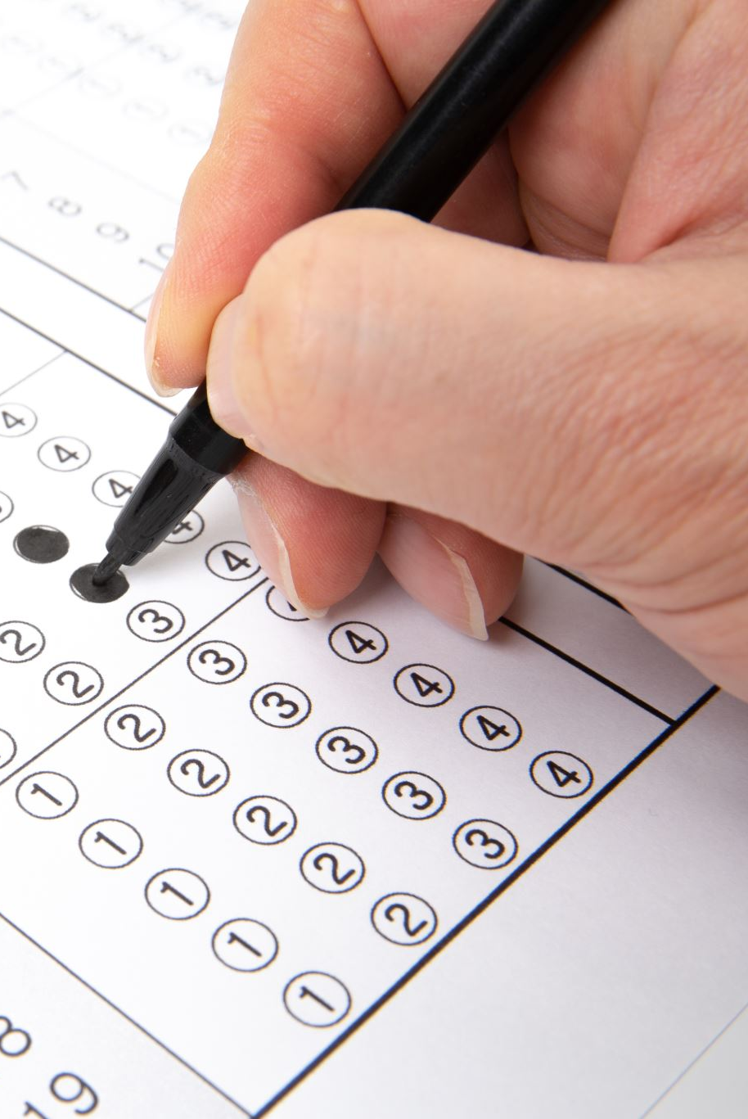
CONDITIONAL STATEMENTS AND DECISION CONTROL STRUCTURE
BY SUBHRANSU SWAIN

Slide 2
types
Conditional statements
Unconditional statements
Iteratives

Slide 3

Conditional statements
Conditional statements help you to make a decision based on certain conditions. These conditions are specified by a set of conditional statements having boolean expressions which are evaluated to a boolean value of true or false.
These are 3 types:
If statement
Elseif statement
Switch statement

Slide 4
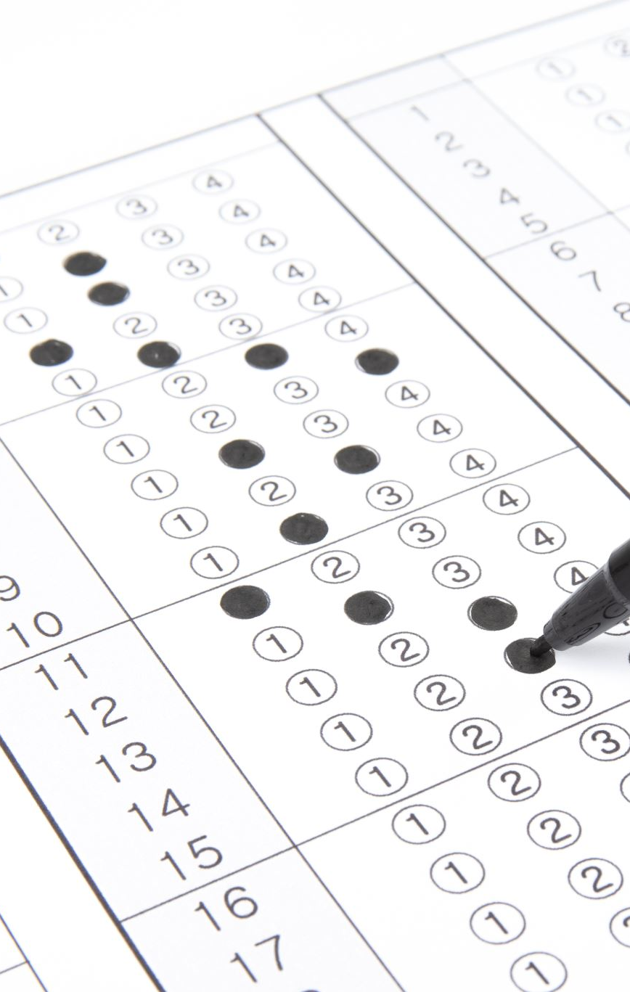
If statement
If statements are logical blocks used within programming.
if (test expression) { // code }

Slide 5
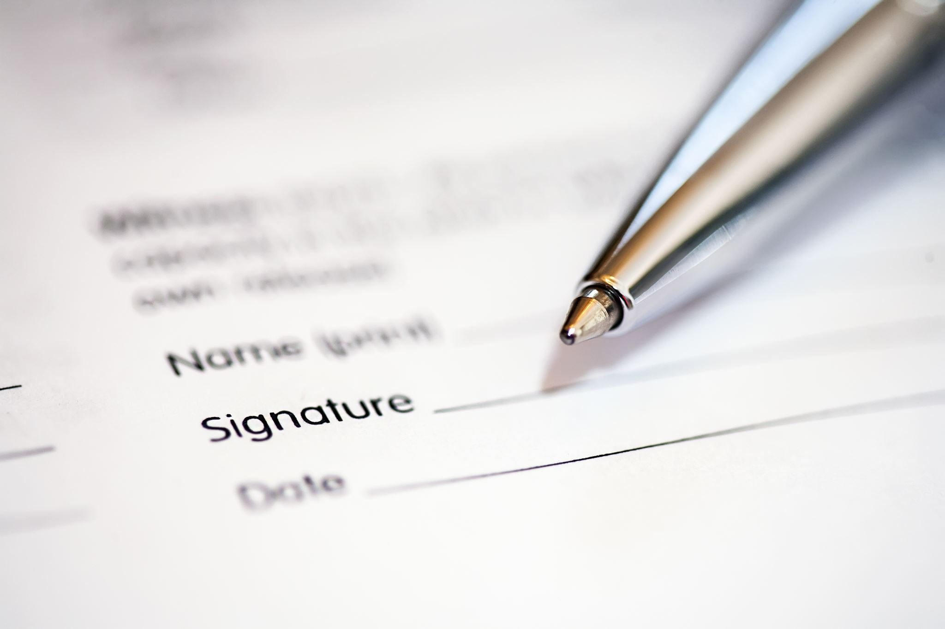
Else statement
if (test expression) { // run code if test expression is true } else { // run code if test expression is false }

Slide 6
Elseif statement
if (test expression1) { // statement(s) } else if(test expression2) { // statement(s) } else if (test expression3) { // statement(s) } . . else { // statement(s) }

Slide 7
Switch statement
switch (expression) ​{ case constant1: // statements break; case constant2: // statements break; . . . default: // default statements }

Slide 8

Unconditional statements
In c, there are control statements that do not need any condition to control the program execution flow. These control statements are called as unconditional control statements. C programming language provides the following unconditional control statements...
break
continue
goto
The above three statements do not need any condition to control the program execution flow.

Slide 9
iteratives
Iteration is the process where a set of instructions or statements is executed repeatedly for a specified number of time or until a condition is met. These statements also alter the control flow of the program and thus can also be classified as control statements in C Programming Language.
Iteration statements are most commonly know as loops. Also the repetition process in C is done by using loop control instruction. There are three types of looping statements:
For Loop
While Loop
Do-while loop

Slide 10

While loop
The while loop evaluates the testExpression inside the parentheses ().
If testExpression is true, statements inside the body of while loop are executed. Then, testExpression is evaluated again.
The process goes on until testExpression is evaluated to false.
If testExpression is false, the loop terminates (ends).
while (testExpression) { // the body of the loop }

Slide 11
Do-While loop
The body of do...while loop is executed once. Only then, the testExpression is evaluated.
If testExpression is true, the body of the loop is executed again and testExpression is evaluated once more.
This process goes on until testExpression becomes false.
If testExpression is false, the loop ends.
do { // the body of the loop } while (testExpression);

Slide 12
For loop
The initialization statement is executed only once.
Then, the test expression is evaluated. If the test expression is evaluated to false, the for loop is terminated.
However, if the test expression is evaluated to true, statements inside the body of the for loop are executed, and the update expression is updated.
Again the test expression is evaluated.
for (initializationStatement; testExpression; updateStatement) { // statements inside the body of loop }

Slide 13

Thank you

